Slide 1
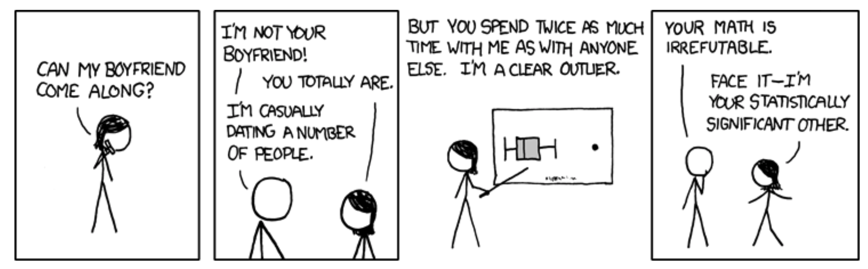
Random vs Fixed Effects Outliers Biology 683 Lecture 8 Heath Blackmon

Slide 2
Last week
General linear models
What should you look at to determine “significance”?
How do you interpret coefficients from glm?

Slide 3
Today
Multiple Fixed effects = Two-factor ANOVA
Random effects
Mixed effects models

Slide 4
What is a fixed effect
These are the variables whose impact we wish to determine
Characteristics of the media or habitat
Alternate medical treatments
Age groups
Time points
Conclusions that you reach are only applicable to the groups or treatments you include in the study

Slide 5
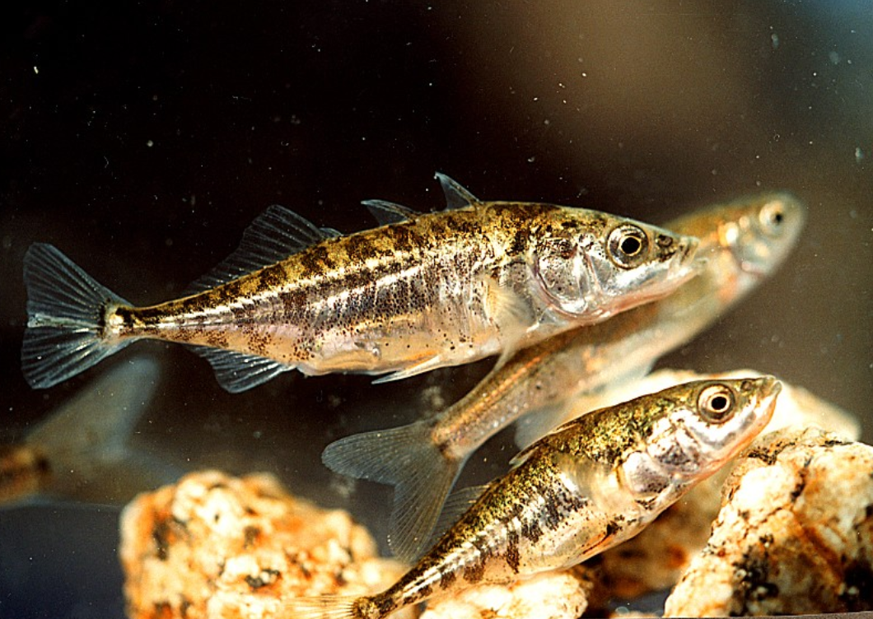
Example of fixed effects
Reciprocal relocation experiment to investigate how genotype and habitat interact to determine the fitness of stickleback fish (Rundle 2002).
 |  | Source habitat
 |  | Shallow | Deep
Test habitat | Shallow | 12 fish | 11 fish
 | Deep | 7 fish | 11 fish

Slide 6
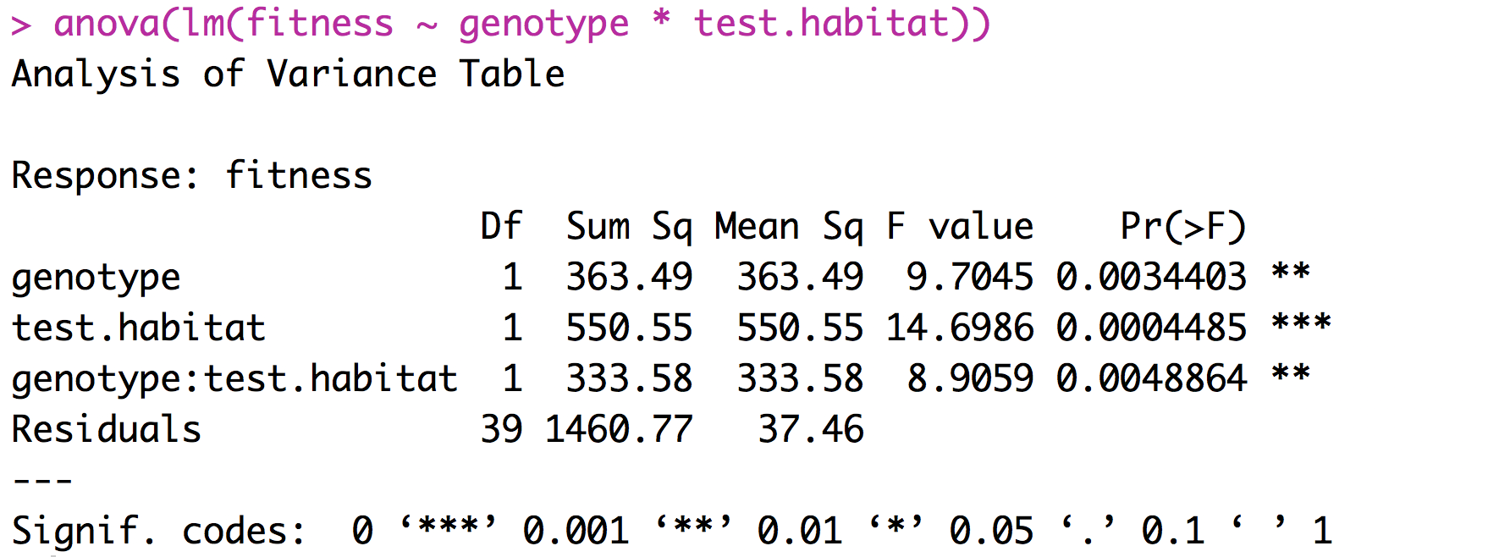
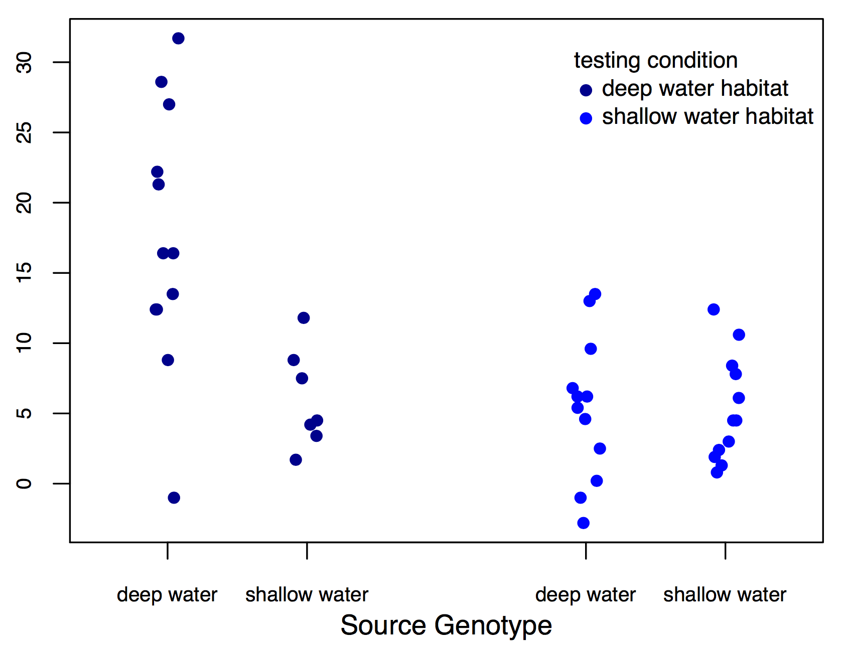
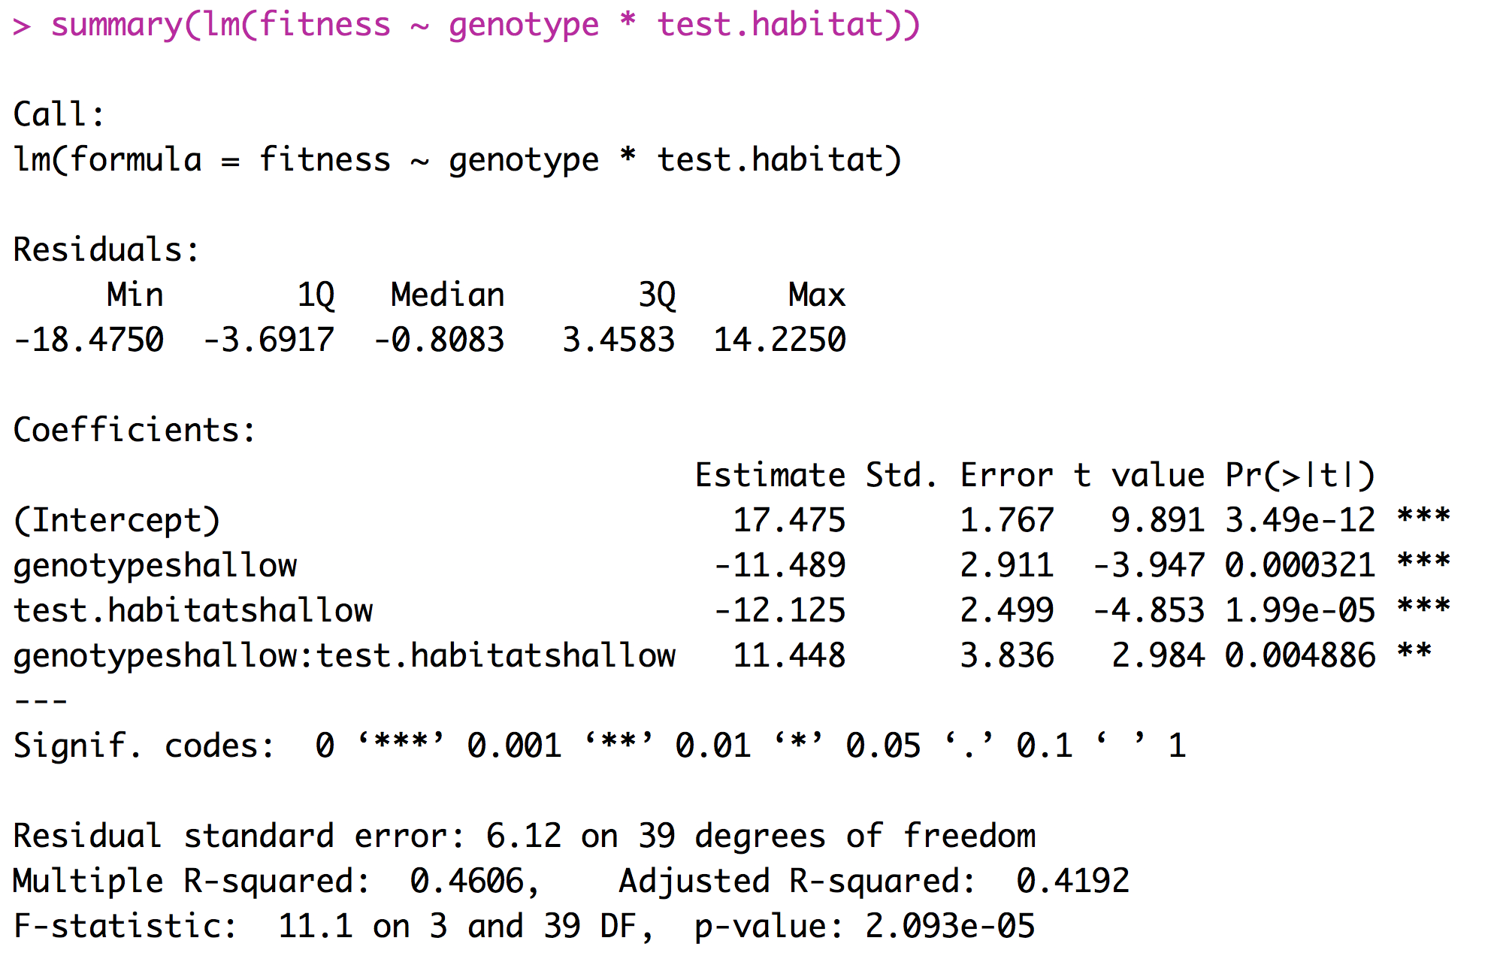
Example of fixed effects (two factor ANOVA)
fitness

Slide 7
Interpreting Coefficients

Slide 8
What is a random effect
These are randomly sampled categories of a variable that represent groups of individual measurements. Usually random effects are not repeatable.
Study sites
Environmental chambers
Families made up of siblings
Measurements within individuals
Conclusions that you reach are applicable only to the sample being studied.

Slide 9
What is a random effect
Sometimes random effects are a nuisance
Field sites
Environmental chambers
Field plots
Repeated measures
Occasionally random effects are of great interest
Families - Heritability
Individuals – Breeding value

Slide 10
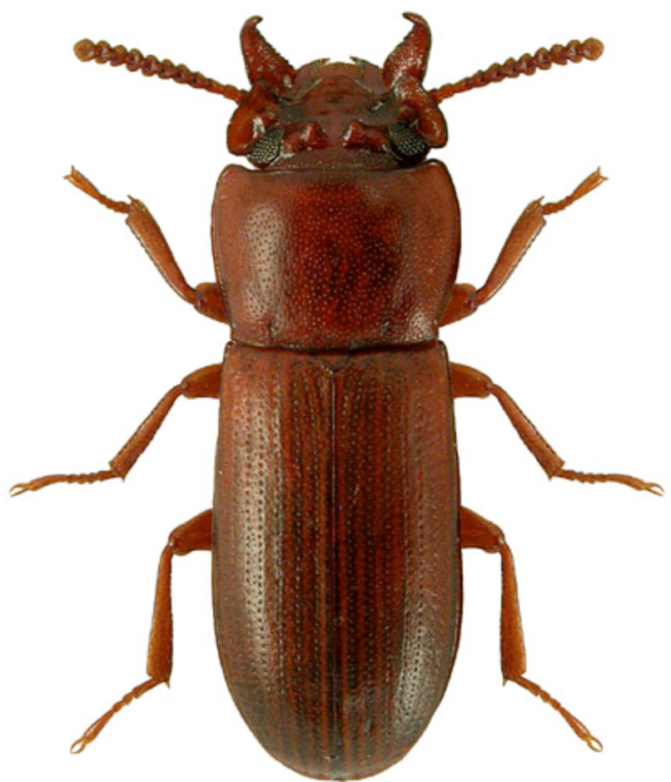
Example of random effects
Impact of selective regime on horn size. Measure both the left and right horn in 25 beetles from two different selective regimes.
Horn size | Beetle | Selective regime
256 276 321 321 423 401 381 409 | 1 1 2 2 3 3 4 4 | High High High High Low Low Low Low

Slide 11
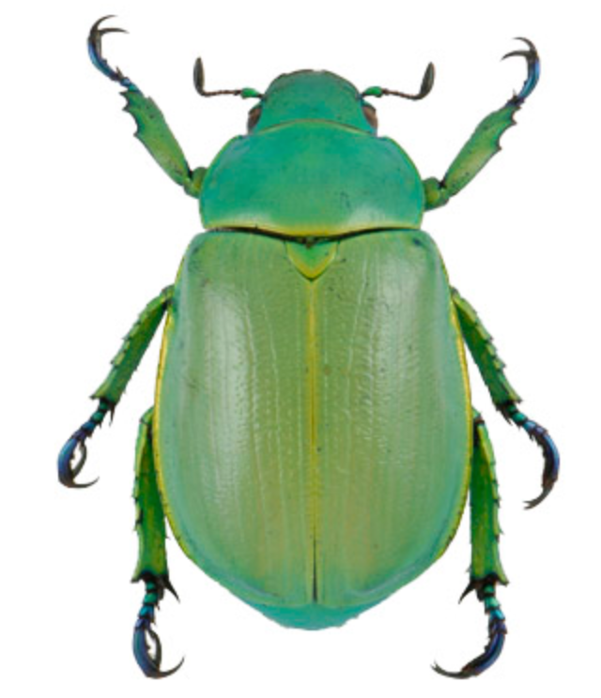
Example of random effects
Identifying the predictors for the presence or absence of Chrysina beetles.
Number collected | oak | juniper | site | date | trip
8 2 1 5 4 6 0 7 | 1 1 0 0 1 1 1 1 | 0 1 1 1 1 0 1 1 | 21 13 31 15 21 13 31 15 | 210 210 211 212 242 242 245 245 | A A A A B B B B

Slide 12
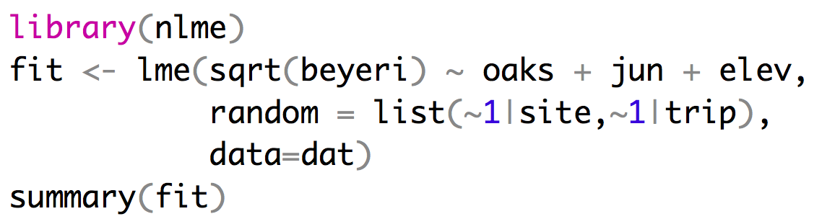
Implementing a mixed effects model
Mixed effect models can be fit using the LME function from the package nlme.
Fixed effects
Random effects
Repeated measures at sites can’t
be treated as independent

Slide 13
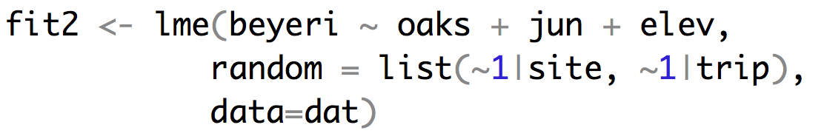
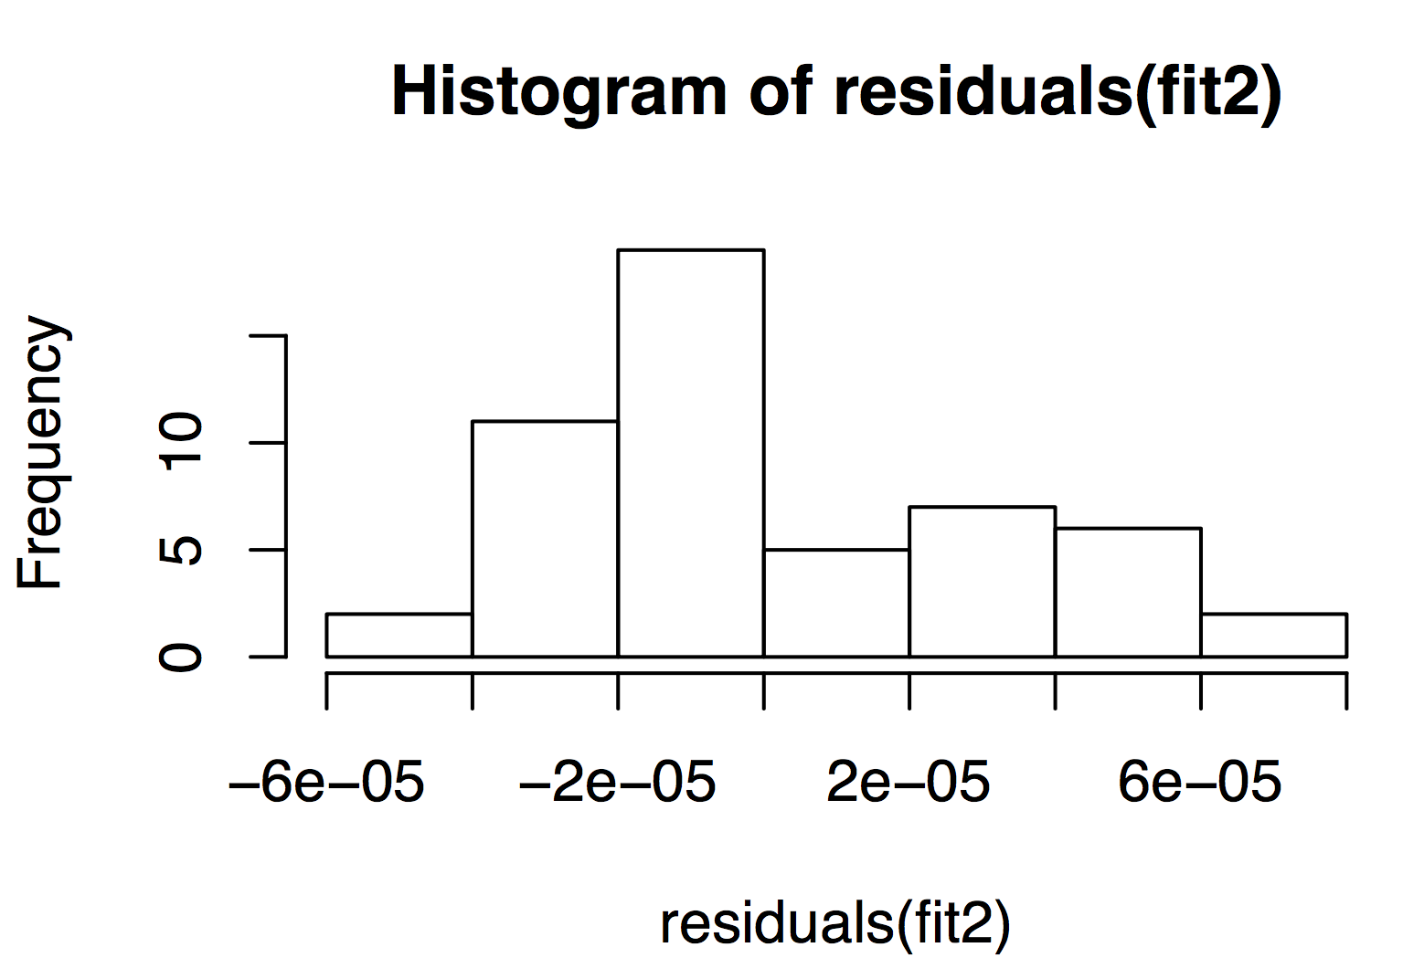
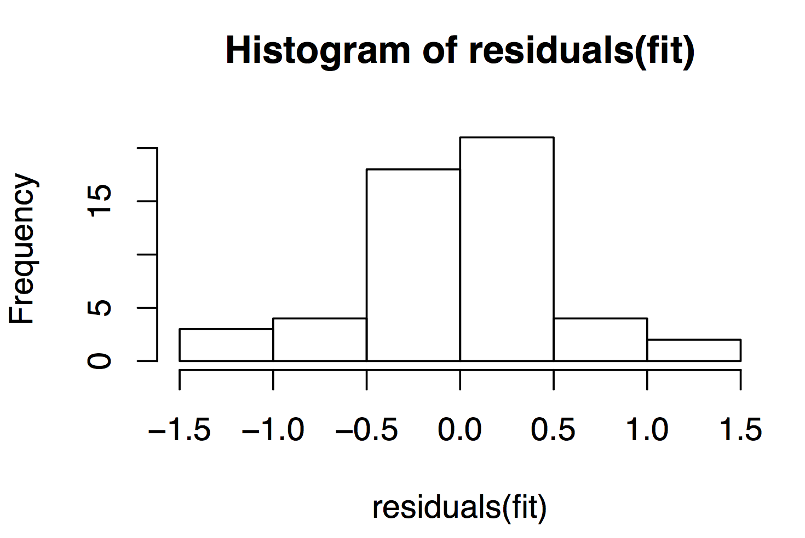
Implementing a mixed effects model

Slide 14
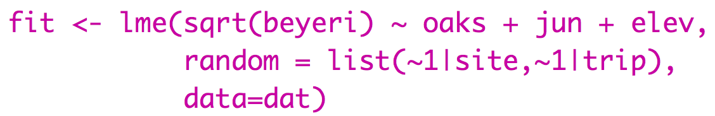
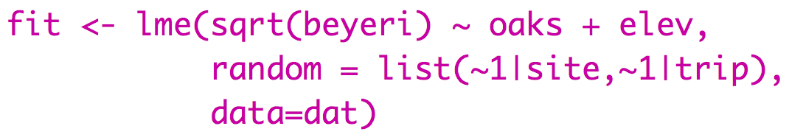
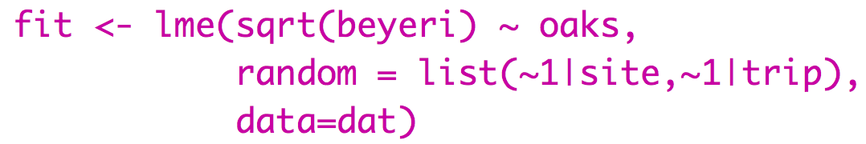
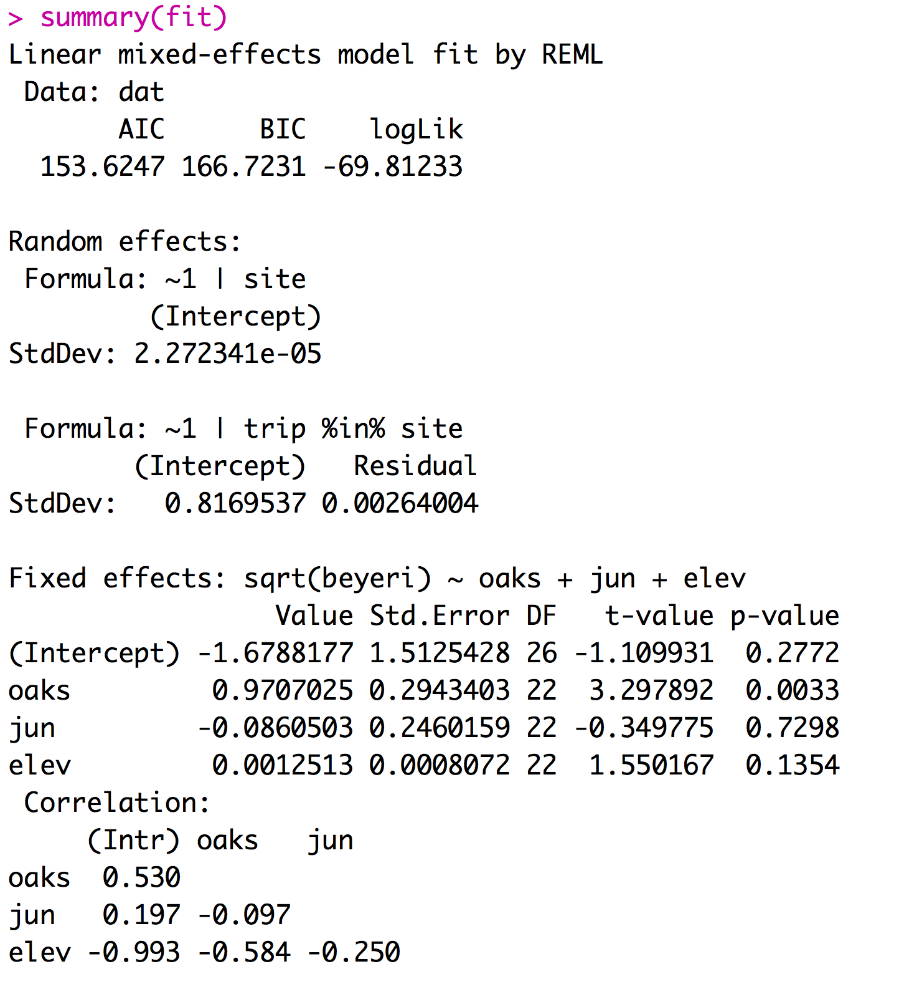
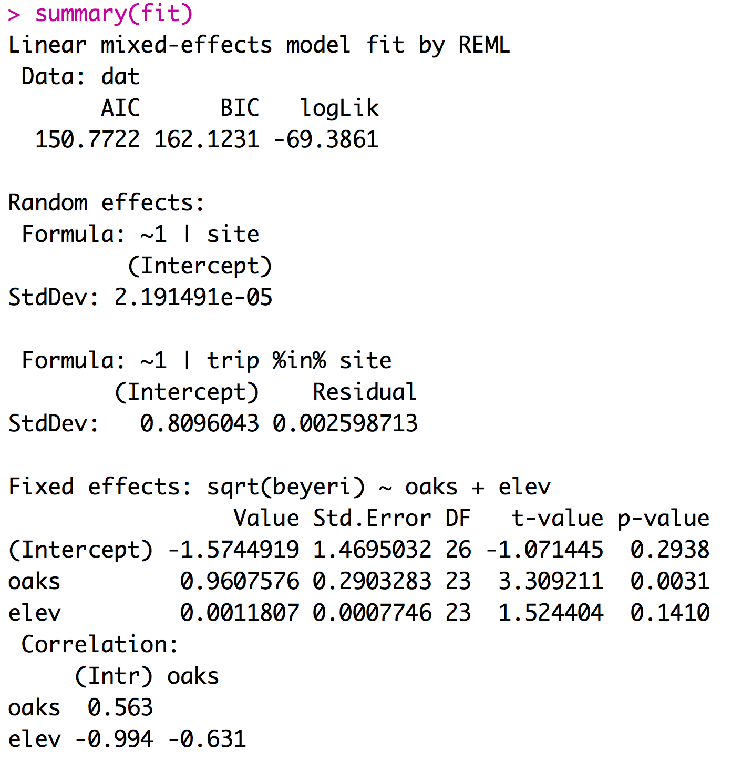
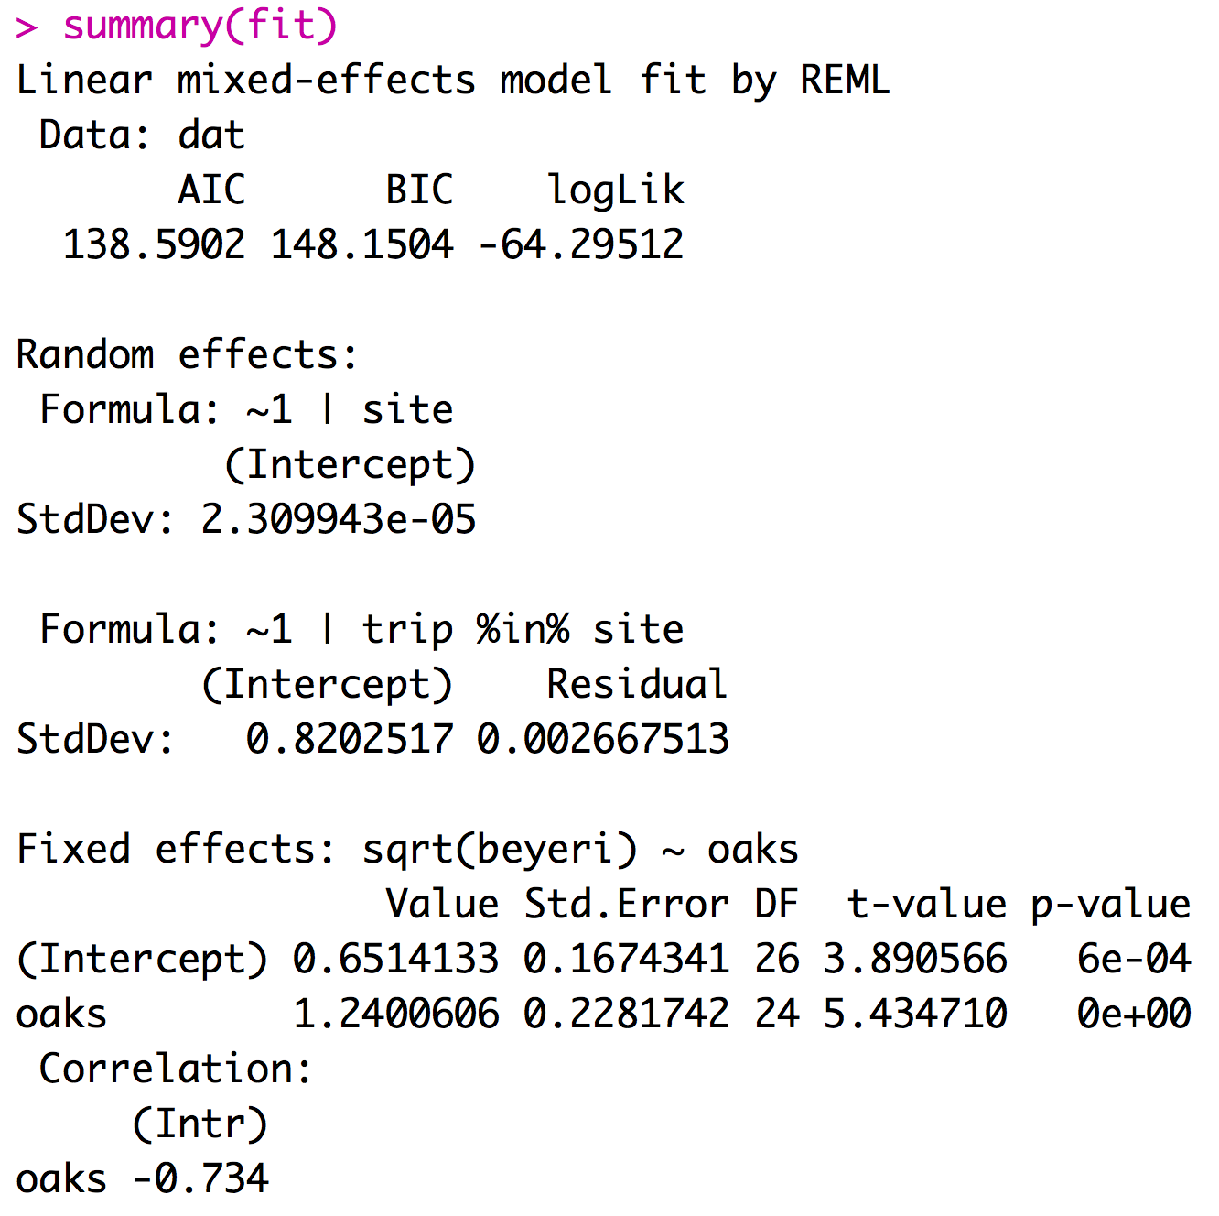
Implementing a mixed effects model
Mixed effect models can be fit using the LME function from the package nlme.
If you report your df with your F-statistic the reviewer will know if you did the right type of model

Slide 15
4 Types of outliers
1) Obviously erroneously recorded or measured data
3) Extreme data point that impacts statistic of interest.
2) Extreme data point that doesn’t impact statistic of interest.
4) Extreme data point that creates significance.

Slide 16
Considerations for models with random effects
Most software will assume that all factors are fixed unless you specify them as mixed.
Designating factors as random effects takes extra work.
The lm function treats all predictors as fixed effects.
Treating random effects as fixed effects is fundamentally wrong.

Slide 17
Links
MCMCMglmm: Fit mixed models with phylogenetic or pedigree information in a Bayesian framework.
Outlier Package: Apply outlier tests to identify possible outlier datapoints - I don’t recommend this.

Slide 18
For Thursday
Go to EIS or TGS (or if you agreed to help me do that)!
Rest of the semester:
Visualizing Data what makes good/bad plots ggplot
Species as data points
Dimensional Reduction
Heath Blackmon
BSBW 309
coleoguy@gmail.com
@coleoguy

